Slide 1
Docker on Windows
Paul Wheeler Solutions Architect Martus Solutions
paul@paulwheeler.com
http://github.com/pwhe23
@paulwheeler

Slide 2
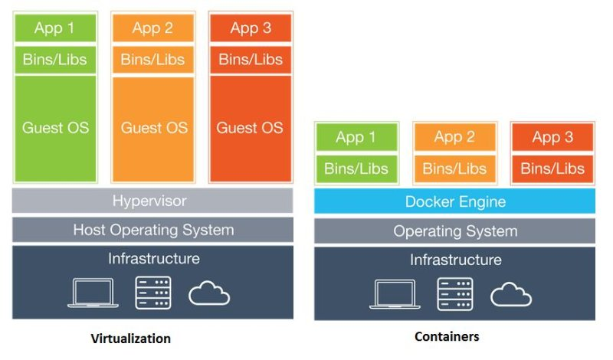
Source: https://www.linkedin.com/pulse/docker-containers-from-mainframe-era-kavungal-kunnumpurath

Slide 3
Why Docker?
The same image can move through all environments to production, not just the binaries, but also the server configuration as part of the image
Docker images can be run and scaled on multiple clouds without using proprietary solutions for each cloud
On Windows, images can be run as normal container processes or as isolated Hyper-V containers
VSTS supports building and deploying Docker images

Slide 4
Hosting
Azure Container Service
Amazon Web Services
Digital Ocean
Exoscale
Google Compute Engine
OpenStack
Rackspace
IBM Softlayer
Docker Machine Support List: https://docs.docker.com/machine/drivers/
Source: https://blog.codeship.com/the-shortlist-of-docker-hosting/

Slide 5
Getting Started
Requires Windows 10 Anniversary Edition or Windows Server 2016
Install Docker for Windows (beta version for Windows Container support)
https://docs.docker.com/docker-for-windows/
Enable-WindowsOptionalFeature -Online -FeatureName containers -All
Enable-WindowsOptionalFeature -Online -FeatureName Microsoft-Hyper-V –All
Restart-Computer -Force
Install Visual Studio Tools for Docker (Optional)
Enables debugging Linux containers from Visual Studio
https://visualstudiogallery.msdn.microsoft.com/0f5b2caa-ea00-41c8-b8a2-058c7da0b3e4

Slide 6
Docker "Hello World“ with Linux
Runs Linux container via a MobyLinuxVM Hyper-V virtual machine
docker run hello-world
note each "run" command creates a new container
List all containers (include inactive)
docker ps -a
Remove containers (-f is force, even if running)
docker rm -f <HASH>
List images
docker images
Remove image
docker rmi <HASH>
Source: https://docs.docker.com/docker-for-windows/

Slide 7
Debug Container in Visual Studio
Visual Studio Tools for Docker
https://visualstudiogallery.msdn.microsoft.com/0f5b2caa-ea00-41c8-b8a2-058c7da0b3e4
Supports debugging on Linux containers
Create new Asp.net Core Web Application (.Net Core)
Docker > Settings > Shared Drives > select drives > Apply
Right-click Project > Add > Docker Support
Note new solution items:
Dockerfile configures docker build image process, what to execute when run
Docker-compose.yml manages environment variables and multiple image relationships if necessary
Start option Docker

Slide 8
Docker Process
Add dockerfile
Instructs docker which base image to use, the steps to use to build the image, what to expose to the outside world, and which process to launch and monitor
Build Image
docker build -t site1 .
Done once to create the reusable binary that contains the application and server configuration
This can be done locally or as part of continuous deployment
Run Image
docker run -d -p 5000:5000 --name site1 site1
A single image can be run as multiple instances, but each needs its own name

Slide 9
Asp.net Core with Linux Container
Add linux dockerfile to AspnetCoreWebsite1
dotnet publish
Build Image
-t gives image name (uppercase not allowed)
. is context directory
docker build -t aspnet-core-website1 .
Run Image as new Container
-d runs as daemon in the background
-p maps external to internal ports
--name is container name
docker run -d -p 5000:5000 --name aspnet-core-website1 aspnet-core-website1
http://localhost:5000/

Slide 10
Windows container running Powershell script
Linux and Windows images and containers are completely separated
Right-click Docker icon in system tray > Switch to Windows Containers
docker pull microsoft/nanoserver (pull down image)
docker run -it microsoft/nanoserver cmd (run command inside image)
powershell.exe Add-Content C:\helloworld.ps1 'Write-Host "Hello World from Powershell"'
exit
docker commit {container hash} helloworld (stores changes as new image)
docker run --rm helloworld powershell c:\helloworld.ps1
Note the --rm removes the container when it has completed
Source: https://msdn.microsoft.com/en-us/virtualization/windowscontainers/quick_start/quick_start_windows_10

Slide 11
Asp.net Core with Windows Container
dotnet new
Update project.json and Program.cs
dotnet restore dotnet run dotnet publish
Add dockerfile
docker build -t site2 . docker run -d -p 5000:5000 --name site2 site2 docker inspect -f "{{ .NetworkSettings.Networks.nat.IPAddress }}" site2 docker rm -f site2

Slide 12
Running Classic Asp.net Website in Docker
Create new Asp.net website in Visual Studio
Add dockerfile to AspnetClassicWebsite1
Compile project
Build Docker image docker build -t site1 .
Start container from image docker run -d -p 5000:5000 --name site1 site1
Find IP Address docker inspect -f "{{ .NetworkSettings.Networks.nat.IPAddress }}" site1
Kill container docker rm -f site1

Slide 13
Orchestration
Swarm - manage multiple Docker hosts, both Linux and Windows (docker-machine) https://docs.docker.com/swarm/
Apache Mesos - Program against your datacenter like it’s a single pool of resources http://mesos.apache.org/
DC/OS - Mesosphere Enterprise DC/OS is an enterprise grade datacenter-scale operating system, providing a single platform for running containers, big data, and distributed apps in production. https://mesosphere.com/product/
Marathon - A container orchestration platform for Mesos and DC/OS https://mesosphere.github.io/marathon/
Kubernetes - an open-source system for automating deployment, scaling, and management of containerized applications. http://kubernetes.io/
Google Container Engine - a powerful cluster manager and orchestration system for running your Docker containers. https://cloud.google.com/container-engine/

Slide 14
What else?
Sql Server containers
https://www.windocks.com/
Kitematic GUI to manage image repositories
Use an image with developer tools loaded to execute the build, which is then copied to a separate smaller runtime image
https://blogs.msdn.microsoft.com/stevelasker/2016/09/29/building-optimized-docker-images-with-asp-net-core/
Consider running a registry proxy cache to save time and bandwidth
Windows containers can even run a Hyper-V server, hosting their own containers Inception-style

Slide 15
Resources
https://channel9.msdn.com/Events/dotnetConf/2016/Deploying-ASPNET-Core-applications-using-Docker-Containers
https://blogs.technet.microsoft.com/virtualization/2016/10/18/use-docker-compose-and-service-discovery-on-windows-to-scale-out-your-multi-service-container-application/
https://msdn.microsoft.com/virtualization/
https://github.com/AdaptiveConsulting/ReactiveTraderCloud/blob/master/docs/articles/deploymentWithContainers.md
https://cloudplatform.googleblog.com/2016/10/managing-containerized-ASP.NET-Core-apps-with-Kubernetes.html

